Slide 1

Car Theft Program
Lower Mainload Focus

Slide 2
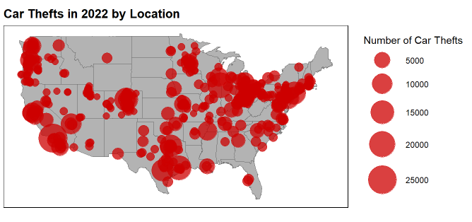
Car Thefts are a Problem Nationwide

Slide 3
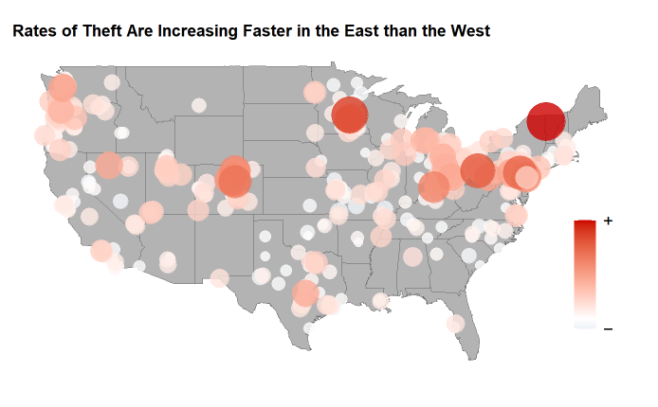
Prevention Efforts have been Successful in Eastern States
Overall deployment of our Theft Program has been a success, but more efforts are necessary.

Slide 4
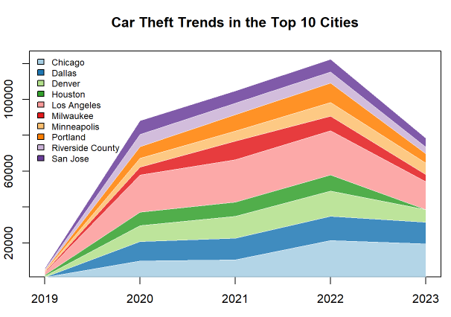
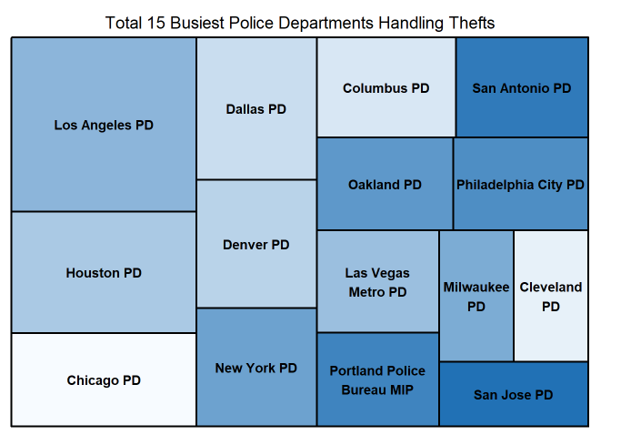
The Busiest Metro PD Departments have had success

Slide 5
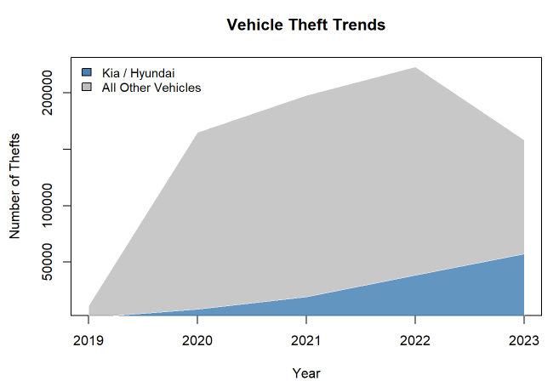
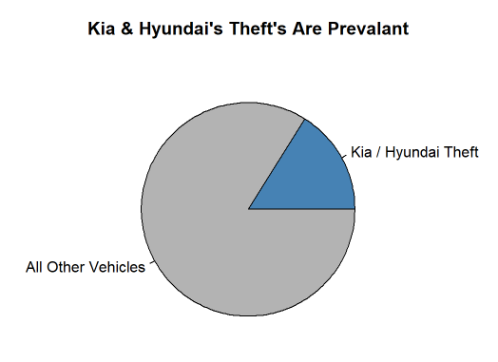
Target Your Local Theft Program Towards Kia/Hyundai

Slide 6
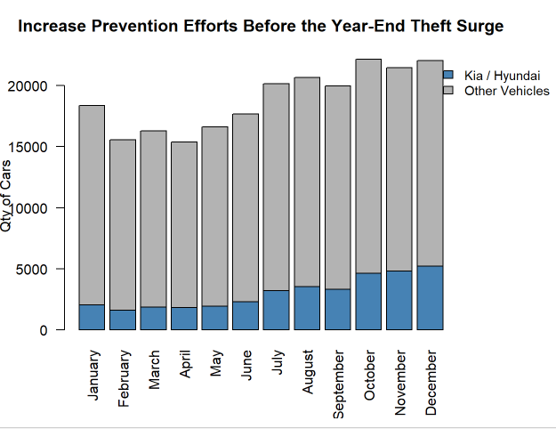
Prepare for the Surge Across all Car Types

Slide 7
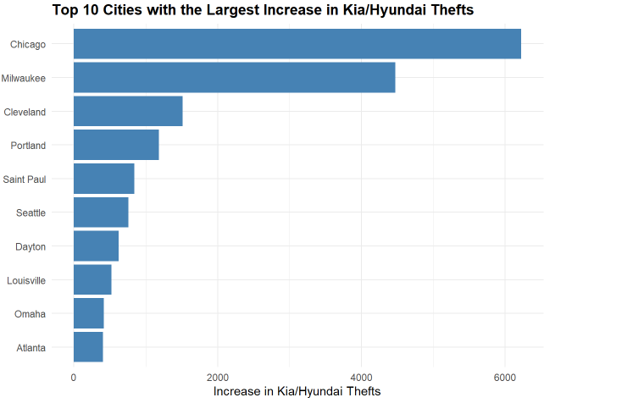
Immediate Intervention Required
These cities should prioritize targeted vehicle theft prevention efforts

